Slide 1


Building an Ontology of Boardgame Mechanics based on the BoardGameGeek Database and the MDA Framework
Joshua Kritz¹
Eduardo Mangeli^{1,2}
Geraldo Xexéo^{1,2}
¹Departamento de Ciência da Computação/ Instituto de Matemática
²Programa de Engenharia de Sistemas e Computação/COPPE

Slide 2
LUDES
LUDES is a laboratory created to research Games and Simulations with the tools of Engineering, aiming to understand:
What is a game
Why people play games
What is quality for games
How to develop games
What are the impacts of games

Slide 3
This work
Built a domain sub-ontology from BGG database
The ontology is not exhaustive
Creating a tool for designers and scholars

Slide 4
BoardGameGeek
One of the biggest and most used Boardgame forum
92018 games, 2536 families, 84 categories, 51 mechanics
User contribution
The BGG 51 mechanics list

Slide 5
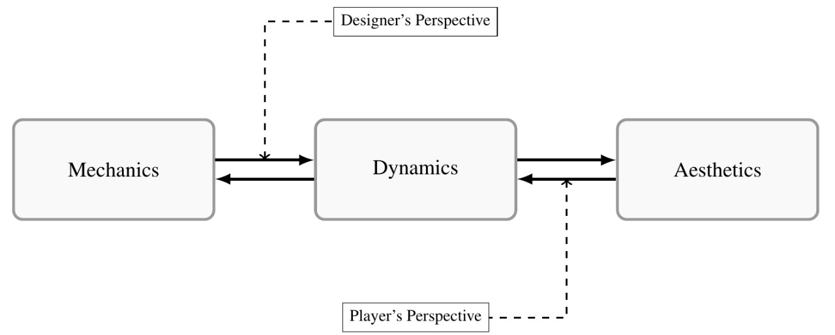
The MDA framework
Mechanics, Dynamics & Aesthetics
Games from the player perspective

Slide 6
Methodology
Based on MENELAS
Built upon common-sense knowledge
Simplicity and adequacy to the domain

Slide 7
Scope
Only concepts identifiable in the BGG mechanics list should appear as leaves of the ontology
For each of the 51 mechanics there should be a decision if it is a mechanic or not accordingly to MDA
Higher level concepts should be based on the MDA Framework, references or on the BGG mechanics list
Compound mechanics should be broken in their constituents

Slide 8
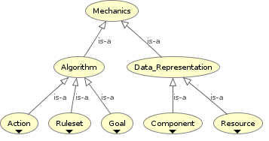
The Ontology

Slide 9
The Ontology
Part-of Relations
BGG mechanics left out:
Hex & Counter (Grid Movement & Token)
Deck Building (Pool Building & Card)
Crayon Rail System (Network Building & Paper and pencil)
Not Mechanics:
Hand Management
Simulation

Slide 10
Conclusion
The Ontology must be improved
Some questions answered…
Future steps...
To a brighter future

Slide 11
LUDES.COS.UFRJ.BR
Joshua Kritz – joshuak@cos.ufrj.br
Eduardo Mangeli – mageli@cos.ufrj.br
Geraldo Xexéo – xexeo@cos.ufrj.br
For papers, games and other work, please consult our website

